Slide 1
Machine Learning
Machine Learning Introduction to Machine Learning by Kumar Anurupam is licensed under a Creative Commons Attribution-4.0 International License.
Artificial Neural Networks – Introduction
CS 3104 Fall 2019
Lecture Slides by Kumar Anurupam

Slide 2
Learning Objectives
After completion of today’s session you will be able to:
Explain the Biological Background behind Artificial Neural Network.
Illustrate the resemblance of Biological and Artificial Neural Network.
Elaborate the concept of ANN.

Slide 3
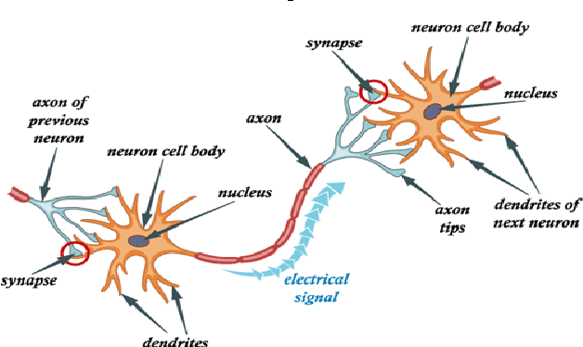
Neural Network: A Biological Background
The human brain is made up of billions of simple processing units – neurons.
A nerve cell (neuron) is a special biological cell that processes information.
According to an estimation, there are huge number of neurons, approximately 10¹¹ with numerous interconnections, approximately 10¹⁵.
Soma

Slide 4
Working of Biological Neuron Network(BNN)
A typical Neuron consists of four main parts:
Dendrites − They are tree-like branches, responsible for receiving the information(Electrical Impulses/Spikes) from other neurons it is connected to. In other sense, we can say that they are like the ears of neuron.
Soma − It is the cell body of the neuron and is responsible for processing of information, they have received from dendrites.
Axon − It is just like a cable through which neurons send the information.
Synapses − It is the connection between the axon and other neuron dendrites.

Slide 5
Artificial Neural Network(ANN)
ANN is an information processing paradigm inspired by biological nervous systems.
ANNs are also named as “artificial neural systems,” or “parallel distributed processing systems,” or “connectionist systems.”
ANN acquires a large collection of units that are interconnected in some pattern to allow communication between the units. These units, also referred to as nodes or neurons, are simple processors which operate in parallel.
A neural network is a series of algorithms that endeavors to recognize underlying relationships in a set of data through a process that mimics the way the human brain operates.
Neural networks can adapt to changing input; so the network generates the best possible result without needing to redesign the output criteria.

Slide 6
ANN VS BNN
BNN | ANN
Soma | Node
Dendrites | Input
Synapse | Weights or Interconnections
Axon | Output

Slide 7
ANN vs BNN
Criteria | BNN | ANN
Processing | Massively parallel, slow but superior than ANN | Massively parallel, fast but inferior than BNN
Size | 10¹¹ neurons and 10¹⁵ interconnections | 10² to 10⁴ nodes (mainly depends on the type of application and network designer)
Learning | They can tolerate ambiguity | Very precise, structured and formatted data is required to tolerate ambiguity
Fault tolerance | Performance degrades with even partial damage | It is capable of robust performance, hence has the potential to be fault tolerant
Storage capacity | Stores the information in the synapse | Stores the information in continuous memory locations

Slide 8
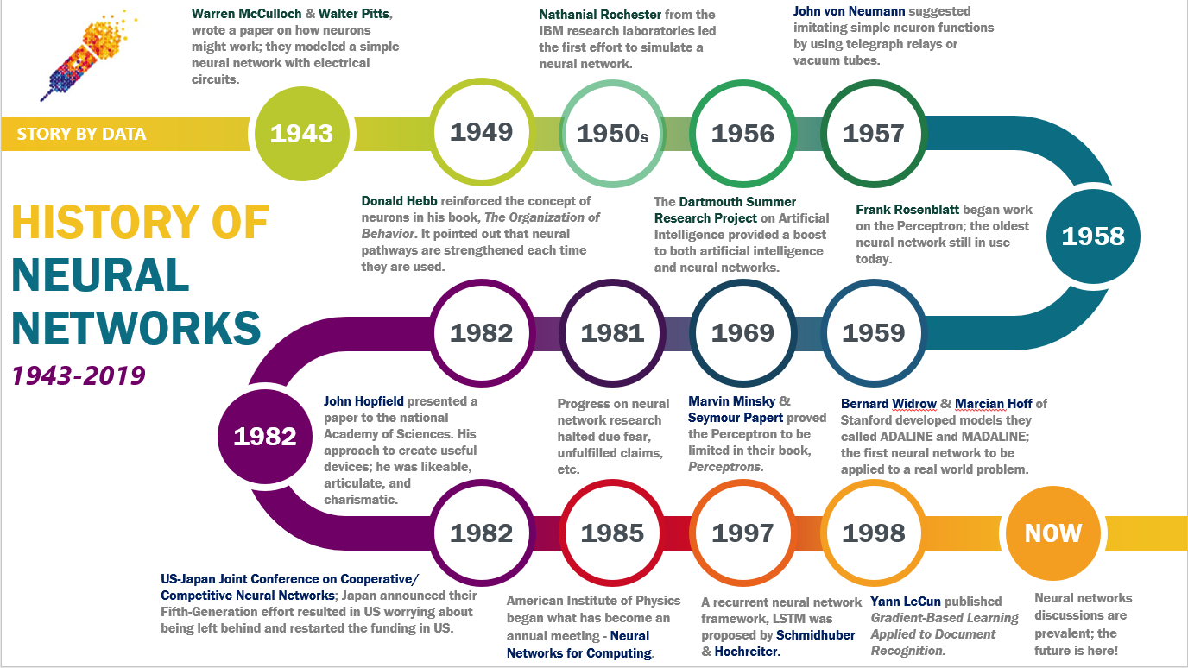
History of ANN :
1890: William James - defined a neuronal process of learning

Slide 9
ANN basic working
Every neuron is connected with other neuron through a connection link.
Each connection link is associated with a weight that has information about the input signal.
This is the most useful information for neurons to solve a particular problem because the weight usually excites or inhibits the signal that is being communicated.
Each neuron has an internal state, which is called an activation signal.
Output signals, which are produced after combining the input signals and activation rule, may be sent to other units.

Slide 10
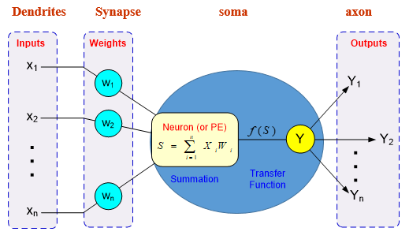
Processing Information in ANN
A single neuron (processing element – PE) with inputs and outputs

Slide 11
Advantages of ANN
A neural network can perform tasks that a linear program can not.
When an element of the neural network fails, it can continue without any problem by their parallel nature.
A neural network learns and does not need to be reprogrammed.
Unlike many other prediction techniques, ANN does not impose any restrictions on the input variables

Slide 12
Limitations of ANN
The neural network needs the training to operate.
The architecture of a neural network is different from the architecture of microprocessors, therefore, needs to be emulated.
Requires high processing time for large neural networks.

Slide 13
Applications of ANN
Speech/Character/Face Recognition.
Fraud Detection.
Targeted Marketing.
Financial Forecasting.
And many more…

Slide 14
References
[1]https://www.tutorialspoint.com/artificial_neural_network/artificial_neural_network_basic_concepts.htm
[2] https://medium.com/analytics-vidhya/brief-history-of-neural-networks-44c2bf72eec
[3] https://www.xenonstack.com/blog/artificial-neural-network-applications/

Slide 15
Thanks

